Slide 1
W4111 – Introduction to Databases Section 002, Spring 2024 Lecture 4: ER, Relational, SQL (III)
© Donald F. Ferguson, 2024

Slide 2
W4111 – Introduction to Databases Section 002, Spring 2024 Lecture 4: ER, Relational, SQL (III)
We will start in a couple of minutes.
© Donald F. Ferguson, 2024

Slide 3

Contents
3 | COMS W4111_002_2024_1: Lecture 4: ER, Relational, SQL (III) © Donald F. Ferguson, 2024

Slide 4
Contents
Some Observations
ER (Diagram) Modeling – More Complex Scenarios: Complex Attributes
The Relational Model and Algebra Continued (Chapter 3)
SQL Continued (Chapter 3, 4, 5)
Project Examples:
Web Applications and REST
Data Engineering and Visualization

Slide 5
Some Observations
5 | COMS W4111_002_2024_1: Lecture 4: ER, Relational, SQL (III) © Donald F. Ferguson, 2024

Slide 6
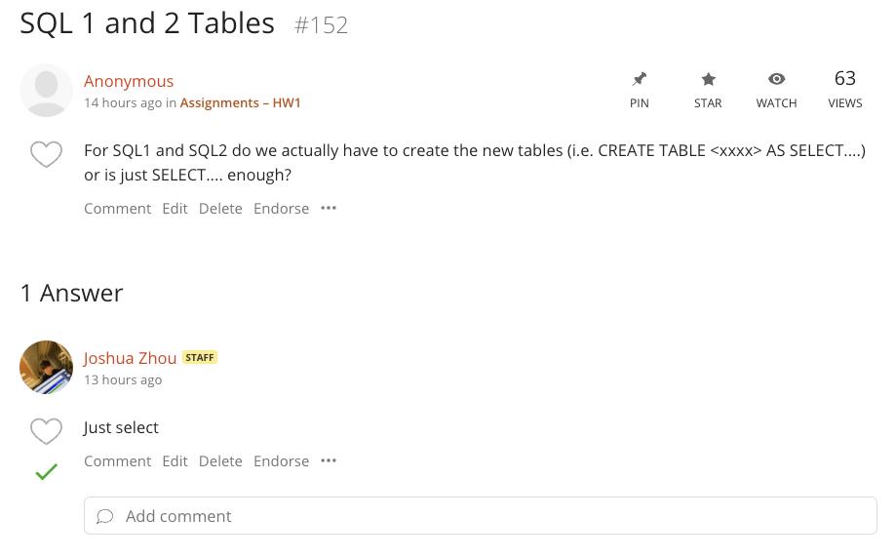
“Create a Table” – Probably not the Best Way to Phrase but Accurate
Like the relational algebra, SQL is closed under non-update operators, e.g.
SELECT
UNION
The result is a table.
There are a few types of table:
Base table
Derived table
Temporary table
View
SELECT, UNION … produce a derived table.
CREATE TEMPORARY TABLE … … creates a table that exists for the session duration (login duration).
We will cover views later.

Slide 7
Database design, Entity-Relationship Model (Continued)
7 | COMS W4111_002_2024_1: Lecture 4: ER, Relational, SQL (III) © Donald F. Ferguson, 2024

Slide 8

Complex Attributes
8 | COMS W4111_002_2024_1: Lecture 4: ER, Relational, SQL (III) © Donald F. Ferguson, 2024

Slide 9
Entity Attributes
The relational model and well-designed SQL schema have atomic attributes.
There are several ways to think about attributes:
Simple (Atomic) vs Composite
Single Valued versus Multi-valued
Derived or Not Derived
And, there can be combinations, for example a Composite, Multi-Value Attribute. Phone number is an example:
A phone number is a composite (+1, 914-555-1212)
A customer may have several: work, home, mobile, … …
Examining name_basics from the IMDB dataset is interesting.

Slide 10
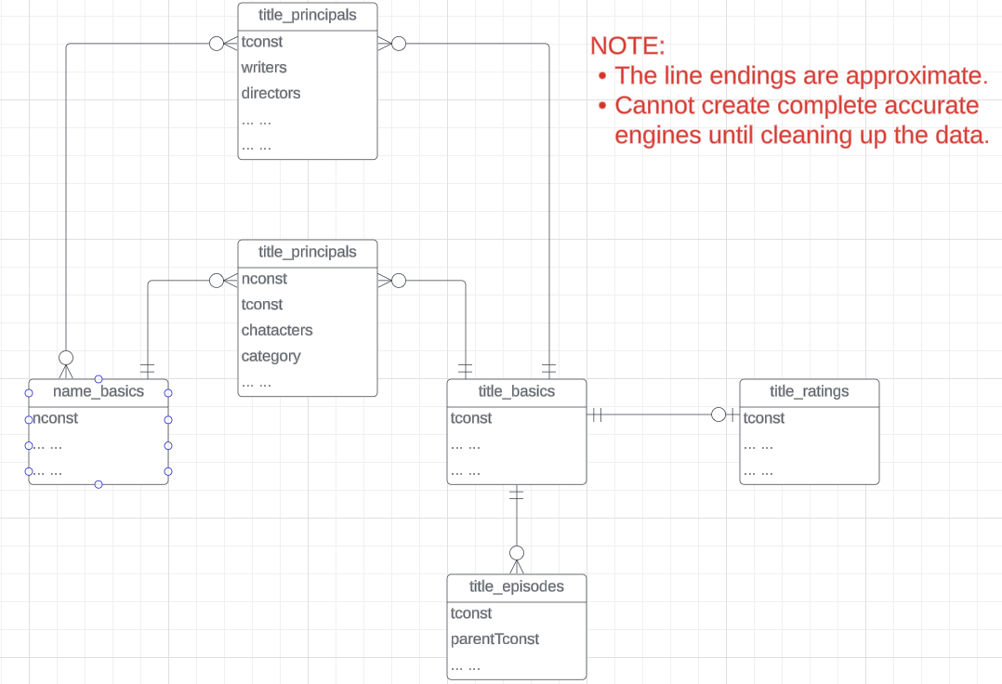
IMDB Free Data
IMDB Free Dataset is a set of TSV files:
Title Basics
Title AKAS
Title Crew
Title Episodes
Title Principals
Title Ratings
Name Basics
The data needs a lot of “clean up.”

Slide 11
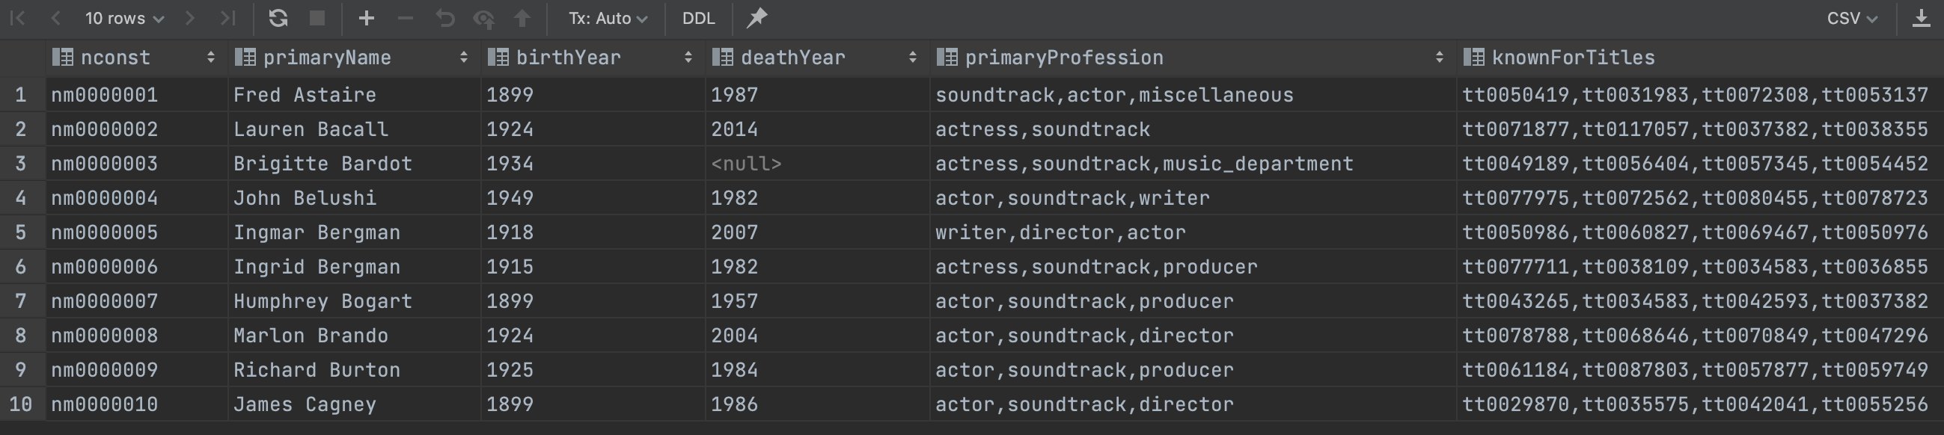
Example from IMDB
Switch to notebook
Consider name_basics
There
Is one composite attribute, primaryName.
Are two multivalued attributes: primaryProfession, knownForTitles
knownForTitles is also tricky, which we will see.
Names are also a little tricky

Slide 12
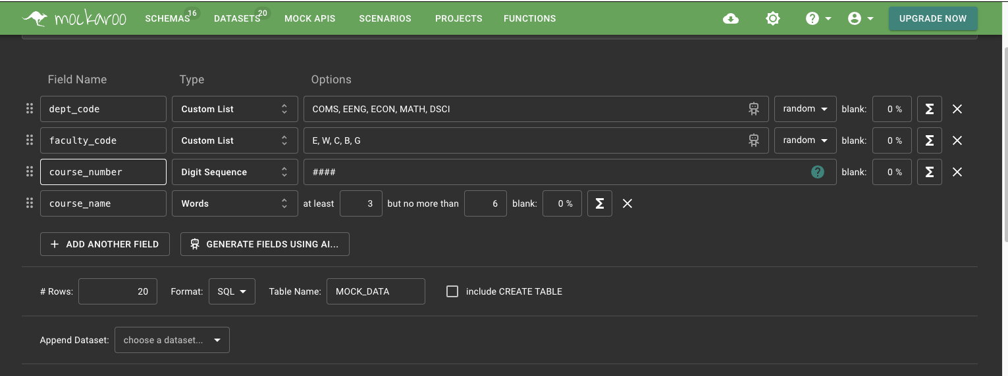
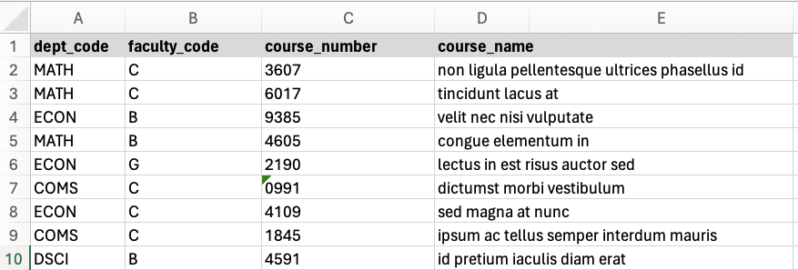
Generated Attributes
Switch to Notebook
Generated some mock data.
Loaded into a make-believe course table in MySQL.

Slide 13
Relational Model and Algebra
13 | COMS W4111_002_2024_1: Lecture 4: ER, Relational, SQL (III) © Donald F. Ferguson, 2024

Slide 14
What are all those other Symbols?
Some of these are obscure and truly bizarre
Division
Anti-Join
Left semi-join
Right semi-join
I must look them up again every semester.
Most SQL engines do not support them.
You can implement them using combinations of JOIN, SELECT, WHERE, ... ...
But, I cannot every remember using them in applications I have developed.
Outer JOIN is very useful, but less common. We will cover.
There are also some “patterns” or “terms”
Equijoin
Non-equi join
Natural join
Theta join
... ...
I may ask you to define these terms on some exams because they may be common internships/job interview questions.
τ order by
γ group by
¬ negation
÷ set division
⨝ natural join, theta-join
⟕ left outer join
⟖ right outer join
⟗ full outer join
⋉ left semi join
⋊ right semi join
▷ anti-join

Slide 15
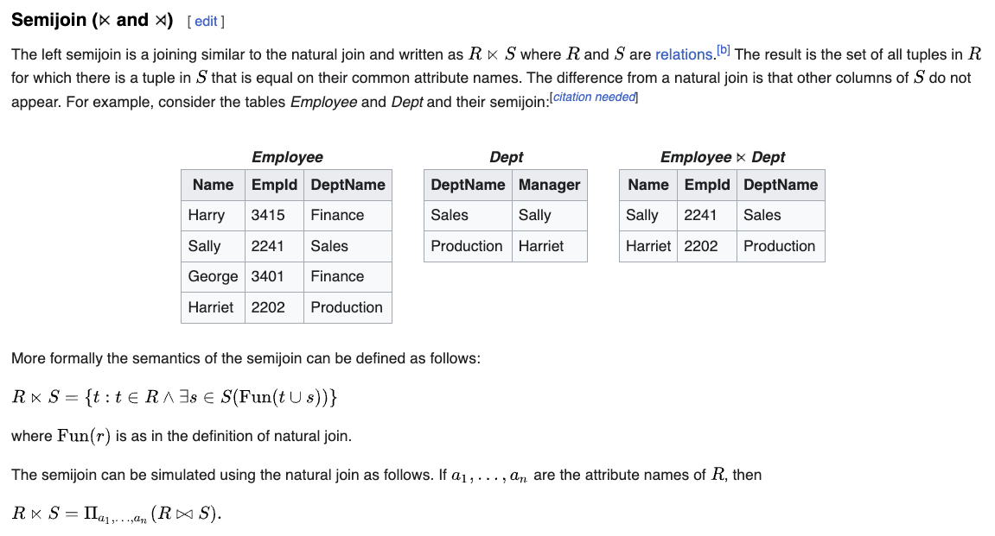
Semi-Join

Slide 16
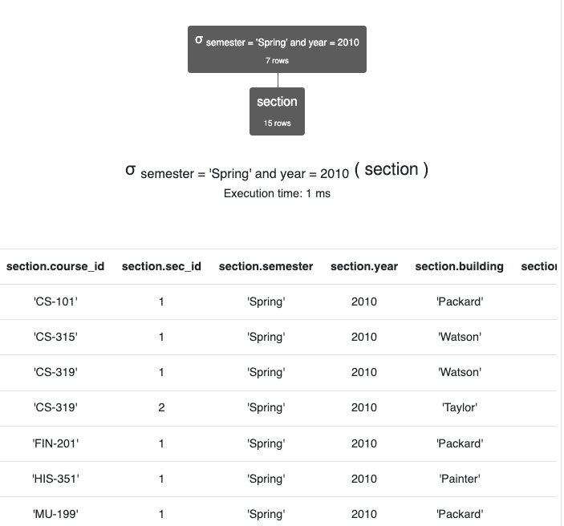
Semi-Join
course ⋉ (σ semester='Spring' ∧ year=2010 (section))
The common column name is course_id.
The query produces the rows from course for which there is section of the course in the Spring of 2010
Note:
Walk through this in detail in RelaX.
We will see the corresponding SQL later.

Slide 17
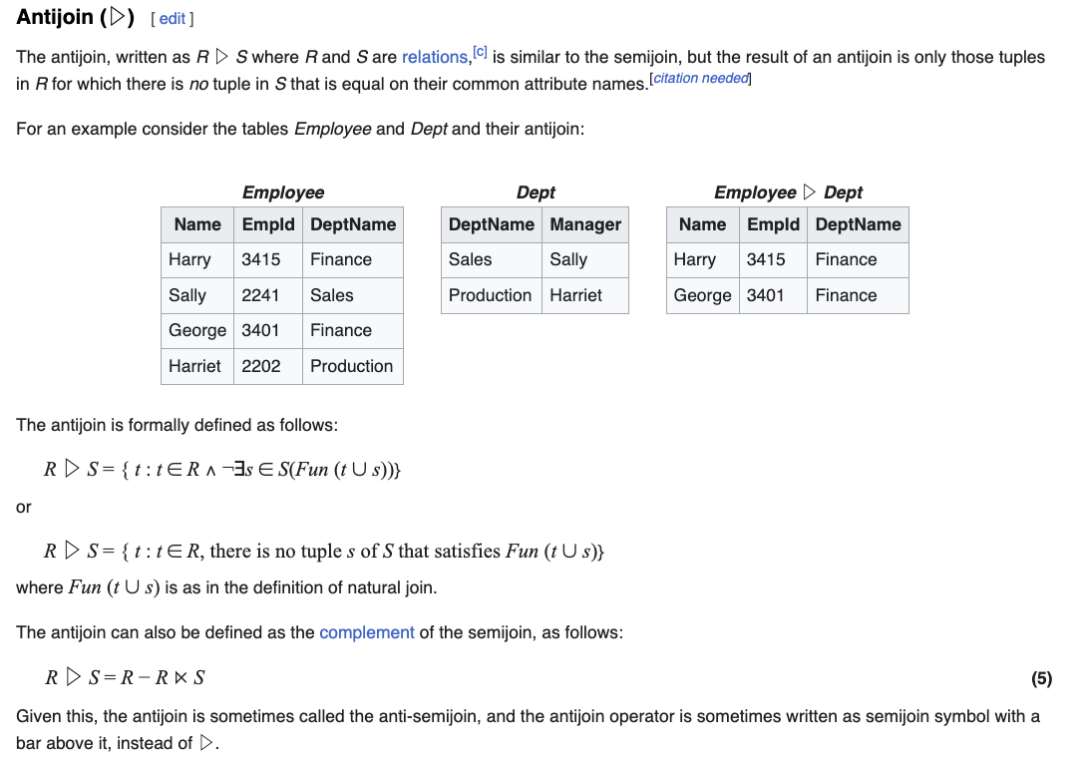
Anti-Join
Using the sample university dataset,
Instructors that are not advisors.
Anti-Join: instructor ▷ ID=i_id advisor
One of many equivalent queries:
π ID, name, dept_name, salary
(σ i_id=NULL
(instructor ⟕ ID=i_id advisor))

Slide 18
Set Division
Scroll through … … https://en.wikipedia.org/wiki/Relational_algebra
I am not even going to try to figure this out right now. I already have a headache.

Slide 19
SQL
19 | COMS W4111_002_2024_1: Lecture 4: ER, Relational, SQL (III) © Donald F. Ferguson, 2024

Slide 20
NULL
20 | COMS W4111_002_2024_1: Lecture 4: ER, Relational, SQL (III) © Donald F. Ferguson, 2024

Slide 21
Codd’s 12 Rules
Rule 4: Active Online Catalog
The structure description of the entire database must be stored in an online catalog, known as data dictionary, which can be accessed by authorized users. Users can use the same query language to access the catalog which they use to access the database itself.
Rule 5: Comprehensive Data Sub-Language Rule
A database can only be accessed using a language having linear syntax that supports data definition, data manipulation, and transaction management operations. This language can be used directly or by means of some application. If the database allows access to data without any help of this language, then it is considered as a violation.
Rule 6: View Updating Rule
All the views of a database, which can theoretically be updated, must also be updatable by the system.
Rule 1: Information Rule
The data stored in a database, may it be user data or metadata, must be a value of some table cell. Everything in a database must be stored in a table format.
Rule 2: Guaranteed Access Rule
Every single data element (value) is guaranteed to be accessible logically with a combination of table-name, primary-key (row value), and attribute-name (column value). No other means, such as pointers, can be used to access data.
Rule 3: Systematic Treatment of NULL Values
The NULL values in a database must be given a systematic and uniform treatment. This is a very important rule because a NULL can be interpreted as one the following − data is missing, data is not known, or data is not applicable.

Slide 22
Codd’s 12 Rules
Rule 10: Integrity Independence
A database must be independent of the application that uses it. All its integrity constraints can be independently modified without the need of any change in the application. This rule makes a database independent of the front-end application and its interface.
Rule 11: Distribution Independence
The end-user must not be able to see that the data is distributed over various locations. Users should always get the impression that the data is located at one site only. This rule has been regarded as the foundation of distributed database systems.
Rule 12: Non-Subversion Rule
If a system has an interface that provides access to low-level records, then the interface must not be able to subvert the system and bypass security and integrity constraints.
Rule 7: High-Level Insert, Update, and Delete Rule
A database must support high-level insertion, updation, and deletion. This must not be limited to a single row, that is, it must also support union, intersection and minus operations to yield sets of data records.
Rule 8: Physical Data Independence
The data stored in a database must be independent of the applications that access the database. Any change in the physical structure of a database must not have any impact on how the data is being accessed by external applications.
Rule 9: Logical Data Independence
The logical data in a database must be independent of its user’s view (application). Any change in logical data must not affect the applications using it. For example, if two tables are merged or one is split into two different tables, there should be no impact or change on the user application. This is one of the most difficult rule to apply.

Slide 23
Codd’s 12 Rules
Rule 3: Systematic treatment of null values:
“Null values (distinct from the empty character string or a string of blank characters and distinct from zero or any other number) are supported in fully relational DBMS for representing missing information and inapplicable information in a systematic way, independent of data type.”
Sometimes programmers and database designers are tempted to use “special values” to indicate unknow, missing or inapplicable values.
String: “”, “NA”, “UNKNOWN”, ...
Numbers: -1, 0, -9999
Indicators can cause confusion because you have to carefully code some SQL statements to the specific, varying choices programmers made.

Slide 24
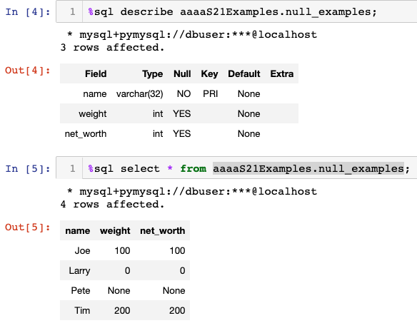
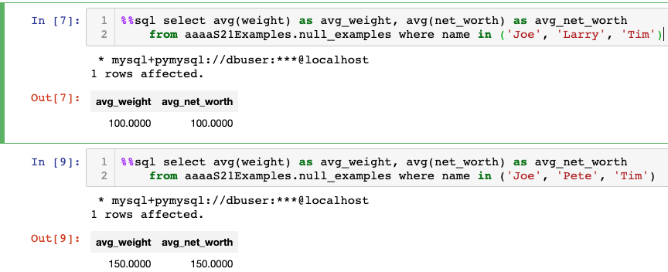
NULL and Correct Answers
Without NULL, to get a correct answer:
I must understand the domain to determine “unknown” values or know what choice a developer made.
Explicitly include “where weight != 0” in all statements.
And this varies from column to column, table to table, schema to schema, etc.

Slide 25
Null Values
It is possible for tuples to have a null value, denoted by null, for some of their attributes
null signifies an unknown value or that a value does not exist.
The result of any arithmetic expression involving null is null
Example: 5 + null returns null
The predicate is null can be used to check for null values.
Example: Find all instructors whose salary is null.
select name from instructor where salary is null
The predicate is not null succeeds if the value on which it is applied is not null.
Note:
NULL is an extremely important concept.
You will find it hard to understand for a while.

Slide 26
Null Values (Cont.)
SQL treats as unknown the result of any comparison involving a null value (other than predicates is null and is not null).
Example: 5 < null or null <> null or null = null
The predicate in a where clause can involve Boolean operations (and, or, not); thus the definitions of the Boolean operations need to be extended to deal with the value unknown.
and : (true and unknown) = unknown, (false and unknown) = false, (unknown and unknown) = unknown
or: (unknown or true) = true, (unknown or false) = unknown (unknown or unknown) = unknown
Result of where clause predicate is treated as false if it evaluates to unknown

Slide 27
String Operations
Between
27 | COMS W4111_002_2024_1: Lecture 4: ER, Relational, SQL (III) © Donald F. Ferguson, 2024

Slide 28
String Operations
SQL includes a string-matching operator for comparisons on character strings. The operator like uses patterns that are described using two special characters:
percent ( % ). The % character matches any substring.
underscore ( _ ). The _ character matches any character.
Find the names of all instructors whose name includes the substring “dar”.
select name from instructor where name like ‘%dar%'
Match the string “100%”
like '100 \%' escape '\'
in that above we use backslash (\) as the escape character.

Slide 29
String Operations (Cont.)
Patterns are case sensitive.
Pattern matching examples:
'Intro%' matches any string beginning with “Intro”.
'%Comp%' matches any string containing “Comp” as a substring.
'_ _ _' matches any string of exactly three characters.
'_ _ _ %' matches any string of at least three characters.
SQL supports a variety of string operations such as
concatenation (using “||”)
converting from upper to lower case (and vice versa)
finding string length, extracting substrings, etc.

Slide 30
Ordering the Display of Tuples
List in alphabetic order the names of all instructors
select distinct name from instructor order by name
We may specify desc for descending order or asc for ascending order, for each attribute; ascending order is the default.
Example: order by name desc
Can sort on multiple attributes
Example: order by dept_name, name
Show notebook for order by example.

Slide 31
Where Clause Predicates
SQL includes a between comparison operator
Example: Find the names of all instructors with salary between $90,000 and $100,000 (that is, ≥ $90,000 and ≤ $100,000)
select name from instructor where salary between 90000 and 100000
Tuple comparison
select name, course_id from instructor, teaches where (instructor.ID, dept_name) = (teaches.ID, 'Biology');
Notes:
7

Slide 32
Set Operations
32 | COMS W4111_002_2024_1: Lecture 4: ER, Relational, SQL (III) © Donald F. Ferguson, 2024

Slide 33
Set Operations
Find courses that ran in Fall 2017 or in Spring 2018
(select course_id from section where sem = 'Fall' and year = 2017) union (select course_id from section where sem = 'Spring' and year = 2018)
Find courses that ran in Fall 2017 and in Spring 2018
(select course_id from section where sem = 'Fall' and year = 2017) intersect (select course_id from section where sem = 'Spring' and year = 2018)
Find courses that ran in Fall 2017 but not in Spring 2018
(select course_id from section where sem = 'Fall' and year = 2017) except (select course_id from section where sem = 'Spring' and year = 2018)

Slide 34
Set Operations (Cont.)
Set operations union, intersect, and except
Each of the above operations automatically eliminates duplicates
To retain all duplicates use the
union all,
intersect all
except all.

Slide 35
Subqueries Concepts and Examples (Including Set Membership)
35 | COMS W4111_002_2023_3: Lecture 4: ER, Relational, SQL (III), Applications © Donald F. Ferguson, 2023

Slide 36
Nested Subqueries
SQL provides a mechanism for the nesting of subqueries. A subquery is a select-from-where expression that is nested within another query.
The nesting can be done in the following SQL query select A₁, A₂, ..., A_{n} from r₁, r₂, ..., r_{m} where P
as follows:
From clause: r_{i} can be replaced by any valid subquery
Where clause: P can be replaced with an expression of the form:
B <operation> (subquery)
B is an attribute and <operation> to be defined later.
Select clause:
A_{i} can be replaced be a subquery that generates a single value.
Note:
This is a little cryptic.
I think I know what they mean.
There are some operations we will see later in the material, e.g IN, EXISTS, ... ...

Slide 37
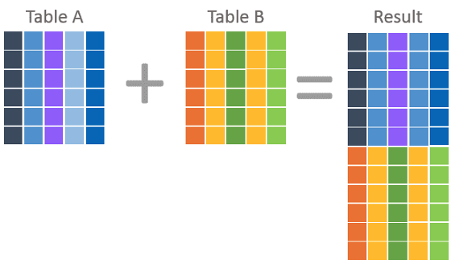
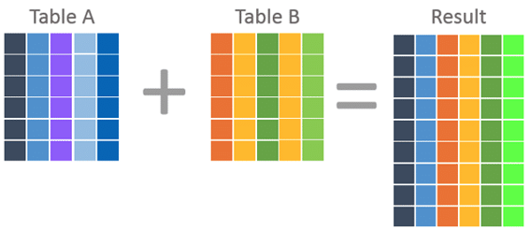
Nested Subquery
The slides that come with the book have surprisingly little material on nested subqueries.
The concept is:
Extremely important.
Students often find subqueries more confusing than joins.
The relationship/difference of subqueries to joins is often, initial unclear.
We have seen:
Union sort of puts a table on top of a table.
Join puts tables sort of puts tables side-by-side.
Subquery enables one query to call another during execution like a subfunction.

Slide 38
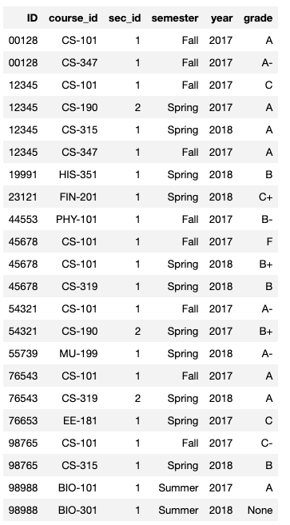
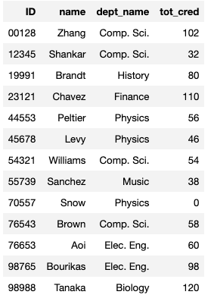
Consider Some Tables
Student
Takes

Slide 39
Consider a Subquery Tables
select *, (select name from student where student.id=takes.id) as name from takes;
Takes
Assume I wrote a function find_student_name(x)
Input is an x
Loops through all students and returns students with student.ID = x.
The query with a subquery above is like:
result = []
For t in takes:
new_r = t + find_student_name(t.id)
result.append(new_r)
Switch to Notebook
Student

Slide 40
Nested Subqueries
SQL provides a mechanism for the nesting of subqueries. A subquery is a select-from-where expression that is nested within another query.
The nesting can be done in the following SQL query select A₁, A₂, ..., A_{n} from r₁, r₂, ..., r_{m} where P
as follows:
From clause: r_{i} can be replaced by any valid subquery
Where clause: P can be replaced with an expression of the form:
B <operation> (subquery)
B is an attribute and <operation> to be defined later.
Select clause:
A_{i} can be replaced be a subquery that generates a single value.
Note: Subquery MUST return
A single scalar if in the SELECT.
A Table if in the FROM.
If in the WHERE:
Either a scalar or a table.
Depending on the operation.

Slide 41
Set Membership

Slide 42
Set Membership
Find courses offered in Fall 2017 and in Spring 2018
Find courses offered in Fall 2017 but not in Spring 2018
select distinct course_id
from section
where semester = 'Fall' and year= 2017 and course_id in (select course_id
from section
where semester = 'Spring' and year= 2018);
select distinct course_id
from section
where semester = 'Fall' and year= 2017 and course_id not in (select course_id
from section
where semester = 'Spring' and year= 2018);

Slide 43
Set Membership (Cont.)
Name all instructors whose name is neither “Mozart” nor Einstein”
select distinct name
from instructor
where name not in ('Mozart', 'Einstein')
Find the total number of (distinct) students who have taken course sections taught by the instructor with ID 10101
Note: Above query can be written in a much simpler manner. The formulation above is simply to illustrate SQL features
select count (distinct ID)
from takes
where (course_id, sec_id, semester, year) in (select course_id, sec_id, semester, year
from teaches
where teaches.ID= 10101);

Slide 44
Set Comparison

Slide 45
Set Comparison – “some” Clause
Find names of instructors with salary greater than that of some (at least one) instructor in the Biology department.
Same query using > some clause
select distinct T.name
from instructor as T, instructor as S
where T.salary > S.salary and S.dept name = 'Biology';
select name
from instructor
where salary > some (select salary
from instructor
where dept name = 'Biology');

Slide 46
Definition of “some” Clause
F <comp> some r ⇔ ∃ t ∈ r such that (F <comp> t ) Where <comp> can be: <, ≤, >, =, ≠
0
(5 < some
5
) = true
(read: 5 < some tuple in the relation)
6
0
(5 < some
5
) = false
0
(5 = some
) = true
5
0
(5 ≠ some
5
) = true (since 0 ≠ 5)
(= some) ≡ in
However, (≠ some) ≡ not in

Slide 47
Set Comparison – “all” Clause
Find the names of all instructors whose salary is greater than the salary of all instructors in the Biology department.
select name
from instructor
where salary > all (select salary
from instructor
where dept name = 'Biology');

Slide 48
Definition of “all” Clause
F <comp> all r ⇔ ∀ t ∈ r (F <comp> t)
0
(5 < all
5
) = false
6
6
(5 < all
) = true
10
4
(5 = all
) = false
5
4
(5 ≠ all
) = true (since 5 ≠ 4 and 5 ≠ 6)
6
(≠ all) ≡ not in
However, (= all) ≡ in

Slide 49
Test for Empty Relations
The exists construct returns the value true if the argument subquery is nonempty.
exists r ⇔ r ≠ Ø
not exists r ⇔ r = Ø

Slide 50
Use of “exists” Clause
Yet another way of specifying the query “Find all courses taught in both the Fall 2017 semester and in the Spring 2018 semester”
select course_id from section as S where semester = 'Fall' and year = 2017 and exists (select * from section as T where semester = 'Spring' and year= 2018 and S.course_id = T.course_id);
Correlation name – variable S in the outer query
Correlated subquery – the inner query

Slide 51
Use of “not exists” Clause
Find all students who have taken all courses offered in the Biology department.
Note that X – Y = Ø ⇔ X ⊆ Y
Note: Cannot write this query using = all and its variants
select distinct S.ID, S.name
from student as S
where not exists ( (select course_id
from course
where dept_name = 'Biology')
except
(select T.course_id
from takes as T
where S.ID = T.ID));
First nested query lists all courses offered in Biology
Second nested query lists all courses a particular student took

Slide 52
Test for Absence of Duplicate Tuples
The unique construct tests whether a subquery has any duplicate tuples in its result.
The unique construct evaluates to “true” if a given subquery contains no duplicates .
Find all courses that were offered at most once in 2017
select T.course_id from course as T where unique ( select R.course_id from section as R where T.course_id= R.course_id and R.year = 2017);

Slide 53
Subqueries in the From Clause

Slide 54
Subqueries in the Form Clause
SQL allows a subquery expression to be used in the from clause
Find the average instructors’ salaries of those departments where the average salary is greater than $42,000.”
select dept_name, avg_salary from ( select dept_name, avg (salary) as avg_salary from instructor group by dept_name) where avg_salary > 42000;
Note that we do not need to use the having clause
Another way to write above query
select dept_name, avg_salary from ( select dept_name, avg (salary) from instructor group by dept_name)
as dept_avg (dept_name, avg_salary)
where avg_salary > 42000;

Slide 55
With Clause
The with clause provides a way of defining a temporary relation whose definition is available only to the query in which the with clause occurs.
Find all departments with the maximum budget with max_budget (value) as (select max(budget) from department) select department.name from department, max_budget where department.budget = max_budget.value;

Slide 56
Complex Queries using With Clause
Find all departments where the total salary is greater than the average of the total salary at all departments
with dept _total (dept_name, value) as
(select dept_name, sum(salary)
from instructor
group by dept_name),
dept_total_avg(value) as
(select avg(value)
from dept_total)
select dept_name
from dept_total, dept_total_avg
where dept_total.value > dept_total_avg.value;

Slide 57
Scalar Subquery
Scalar subquery is one which is used where a single value is expected
List all departments along with the number of instructors in each department
select dept_name, ( select count(*) from instructor where department.dept_name = instructor.dept_name) as num_instructors from department;
Runtime error if subquery returns more than one result tuple

Slide 58
Integrity Constraints, Part 1
58 | COMS W4111_002_2023_3: Lecture 4: ER, Relational, SQL (III), Applications © Donald F. Ferguson, 2023

Slide 59
Integrity Constraints
Integrity constraints guard against accidental damage to the database, by ensuring that authorized changes to the database do not result in a loss of data consistency.
A checking account must have a balance greater than $10,000.00
A salary of a bank employee must be at least $4.00 an hour
A customer must have a (non-null) phone number
DFF
Without integrity constraints in the database, maintaining data correctness requires:
Lots of users know what to do and do not make mistakes.
Dozens of programs correctly implement constraints in the code and stay up to date on changes.
Implementing the constraints as part of the schema eliminates many issues.

Slide 60
Constraints on a Single Relation
not null
primary key
unique
check (P), where P is a predicate

Slide 61
Not Null Constraints
not null
Declare name and budget to be not null
name varchar(20) not null budget numeric(12,2) not null

Slide 62
Unique Constraints
unique ( A₁, A₂, …, A_{m})
The unique specification states that the attributes A₁, A₂, …, A_{m} form a candidate key.
Candidate keys are permitted to be null (in contrast to primary keys).

Slide 63
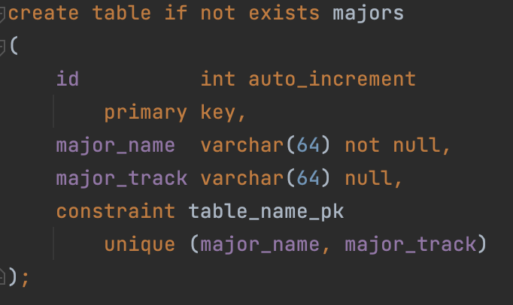
Simple Example
Consider a simple example of an entity class major:
major(id, name, track)
“id” is a uniquely generated ID
“name” is the major name, e.g. “Computer Science,” “Economics,” … …
“track” is a sub-track/specialty within the major, e.g. “Applications,” “AI/ML,” ...
“track” is optional
The combination of (name, track) is unique.
Note: In many DBMS, this automatically creates indices for keys/constraints.
Switch to Notebook.

Slide 64
The check clause
The check (P) clause specifies a predicate P that must be satisfied by every tuple in a relation.
Example: ensure that semester is one of fall, winter, spring or summer
create table section
(course_id varchar (8),
sec_id varchar (8),
semester varchar (6),
year numeric (4,0),
building varchar (15),
room_number varchar (7),
time slot id varchar (4),
primary key (course_id, sec_id, semester, year),
check (semester in ('Fall', 'Winter', 'Spring', 'Summer')))
DFF:
We could handle the semester check with an enum.
Switch to notebook for a slightly different example.

Slide 65
Referential Integrity
Ensures that a value that appears in one relation for a given set of attributes also appears for a certain set of attributes in another relation.
Example: If “Biology” is a department name appearing in one of the tuples in the instructor relation, then there exists a tuple in the department relation for “Biology”.
Let A be a set of attributes. Let R and S be two relations that contain attributes A and where A is the primary key of S. A is said to be a foreign key of R if for any values of A appearing in R these values also appear in S.

Slide 66
Referential Integrity (Cont.)
Foreign keys can be specified as part of the SQL create table statement
foreign key (dept_name) references department
By default, a foreign key references the primary-key attributes of the referenced table.
SQL allows a list of attributes of the referenced relation to be specified explicitly.
foreign key (dept_name) references department (dept_name)

Slide 67
Cascading Actions in Referential Integrity
When a referential-integrity constraint is violated, the normal procedure is to reject the action that caused the violation.
An alternative, in case of delete or update is to cascade
create table course ( (… dept_name varchar(20), foreign key (dept_name) references department on delete cascade on update cascade, . . .)
Instead of cascade we can use :
set null,
set default
DFF:
I do not like using cascade. I think making changes should be explicit.
Other people disagree.
You will get some simple practice on HW or exams.

Slide 68
Indexes Concepts and Examples
68 | COMS W4111_002_2023_3: Lecture 4: ER, Relational, SQL (III), Applications © Donald F. Ferguson, 2023

Slide 69
Index Creation
Many queries reference only a small proportion of the records in a table.
It is inefficient for the system to read every record to find a record with particular value
An index on an attribute of a relation is a data structure that allows the database system to find those tuples in the relation that have a specified value for that attribute efficiently, without scanning through all the tuples of the relation.
We create an index with the create index command
create index <name> on <relation-name> (attribute);

Slide 70
Index Creation Example
create table student (ID varchar (5), name varchar (20) not null, dept_name varchar (20), tot_cred numeric (3,0) default 0, primary key (ID))
create index studentID_index on student(ID)
The query:
select * from student where ID = '12345'
can be executed by using the index to find the required record, without looking at all records of student
DFF:
An index on (column1, column2, column3)
Is also an index on (column1) and (column1, column2)
But not (column2), (column3), (column2, column3).
We will see “why” later in the semester.

Slide 71
Sample Projects
71 | COMS W4111_002_2024_1: Lecture 4: ER, Relational, SQL (III) © Donald F. Ferguson, 2024

Slide 72
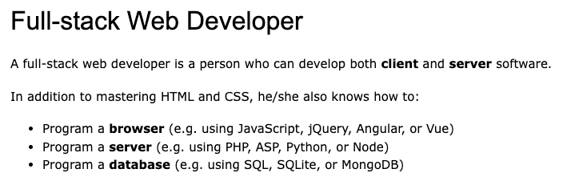
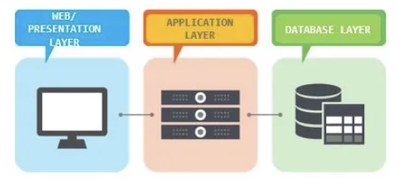
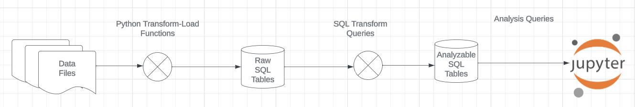
Projects
Both tracks will do some data modeling and data cleanup.
The programming track will implement a simple, full stack web application.
The non-programming track will implement a data engineering and visualization process in a Jupyter notebook.

Slide 73
Game of Thrones
Bottom-Up Data Mapping:
“Nouns” usually map to Entity/Entity Set.
Nouns inside other nouns often map to:
Attribute
Relationship
Verbs often map to relationships.
Adjectives usually map to properties.
We will start with a subset of the information:
Game of Thrones:
Episodes
Characters
IMDB:
names_basics
title_basics
Entities Sets
Character
Season
Episode
Scene
Location, Sublocation
... ...
Relationships
Character – Scene
Character – Character (e.g. KilledBy)
Season – IMDB Title
Character – IMDB Name
... ...

Slide 74
Game of Thrones
Bottom-Up Data Mapping:
“Nouns” usually map to Entity/Entity Set.
Nouns inside other nouns often map to:
Attribute
Relationship
Verbs often map to relationships.
Adjectives usually map to properties.
We will start with a subset of the information:
Game of Thrones:
Episodes
Characters
IMDB:
names_basics
title_basics
Entities Sets
Character
Season
Episode
Scene
Location, Sublocation
... ...
Relationships
Character – Scene
Character – Character (e.g. KilledBy)
Season – IMDB Title
Character – IMDB Name
... ...
IMDB: https://developer.imdb.com/non-commercial-datasets/
Do not download.
Despite being “tiny” compared to the reall world.
The datasets are too big for most laptops.
Game of Thrones: https://github.com/jeffreylancaster/game-of-thrones

Slide 75
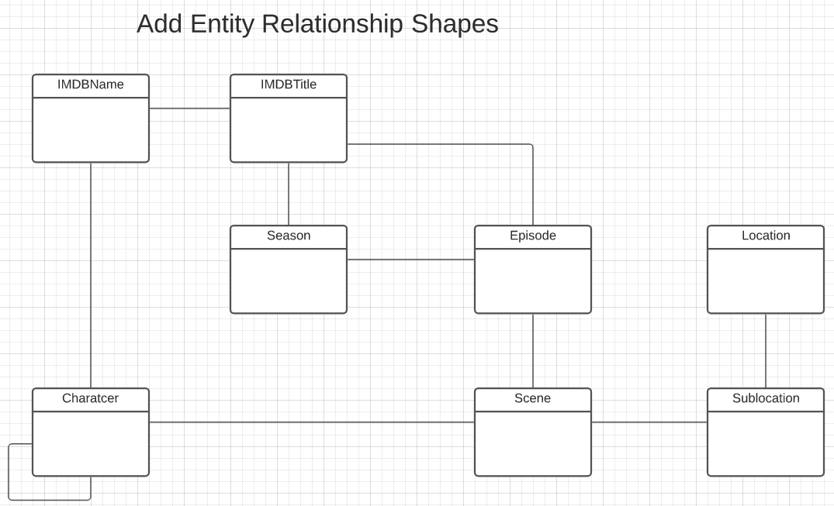
Game of Thrones – Conceptual Model
Add shapes in Lucidchart ...
With a little
Data exploration
Common sense
Judgment/experience
I came to this conceptual model.
Attributes unspecified
Relationship required/cardinality unspecified.
A little more exploration is needed.

Slide 76
Sample Projects
Walkthrough of Web Apps:
/Users/donaldferguson/Dropbox/000/000-A-Current-Examples/W4111-FastAPI-IMDB-Solution
/Users/donaldferguson/Dropbox/000/000-A-Current-Examples/current-dashboard
Data Engineering:
/Users/donaldferguson/Dropbox/000/000-Columbia/2024-Spring/W4111-Intro-to-Databases-Spring-2024/Lectures/s-2024-Lecture-3/More-Data-Engineering.ipynb
And others.

